Slide 1
Health Insurance Marketing Tool
Healthcare Broker Tools
By Cyber Web Group

Slide 2
Introduction
The client “One of the Largest Healthcare Providers in NY State”. (Not specified due to legal obligations)
The need was for a tool to present and sell health plans to different client segments throughout two thirds of New York state.
The segments included Individuals, Small Businesses, and Large Businesses. This includes Medical, Dental, Vision, Medicare, and Admin
This included integration with a third-party call center for Individual plans.
Brokers throughout this region have now used this tool for over a decade to remain competitive and we continue to update and support it as well as fully supporting their amazon ec2 server instances

Slide 3
Features
Web based application allowing searching, filtering, and presenting latest medical, dental, and vision plan information by quarter or year.
Easy comparison to previous plan year information.
Ability to search for new plans based on key filters like copays, deductibles and more.
Ability to generate side by side full detail comparisons of all plan information
Ability to generate PDF of comparisons or individual plans on the fly.
Ability to generate hios id stamped PDF applications from the application in front of clients, once they choose a plan.
Gateway with single sign on security. Separate security to display different features to call center for individual plans through call center integration vs brokers vs employers.
Full admin tool for loading data from a spreadsheet into database tables. Can be adapted for XML data loads
Built on top of WordPress for easy content modification and update of pdf libraries. Secured with built in security auditing and protection from hacking.

Slide 4
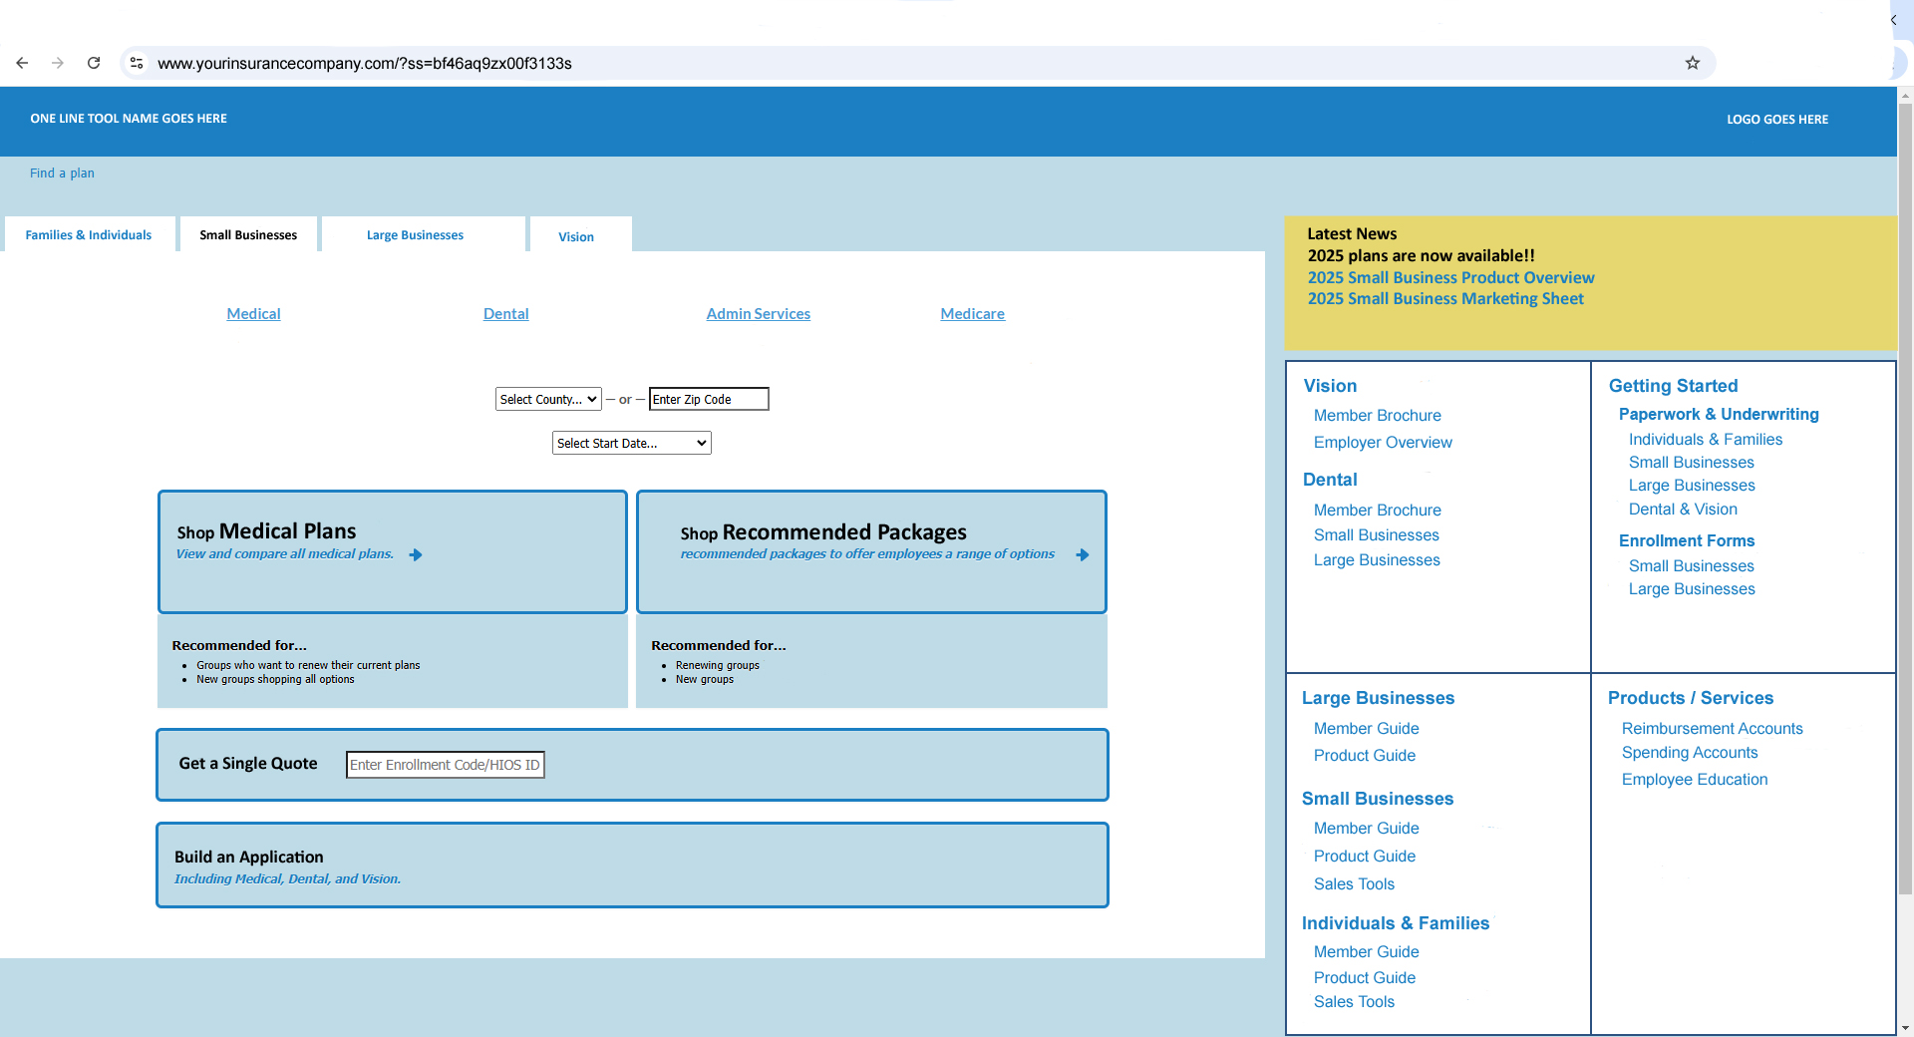
Gateway Landing Page

Slide 5
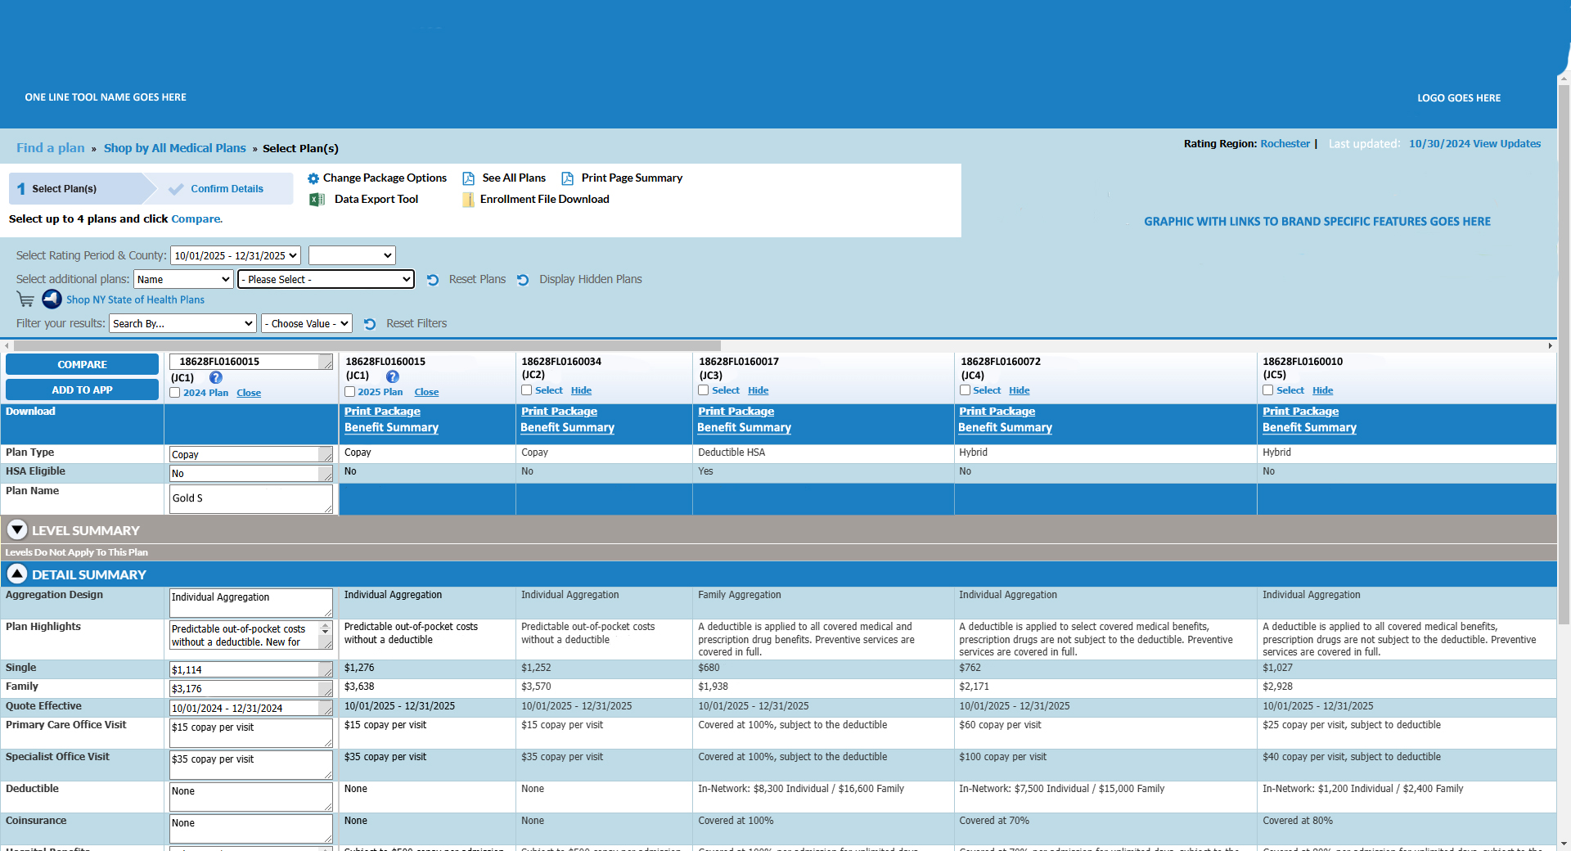
Overview Compare Page
Database Driven
Compare Previous Year
to Current Year
Linkable Graphic Goes Here For
Specific Marketing Initiatives
Dynamically Generated PDF

Slide 6
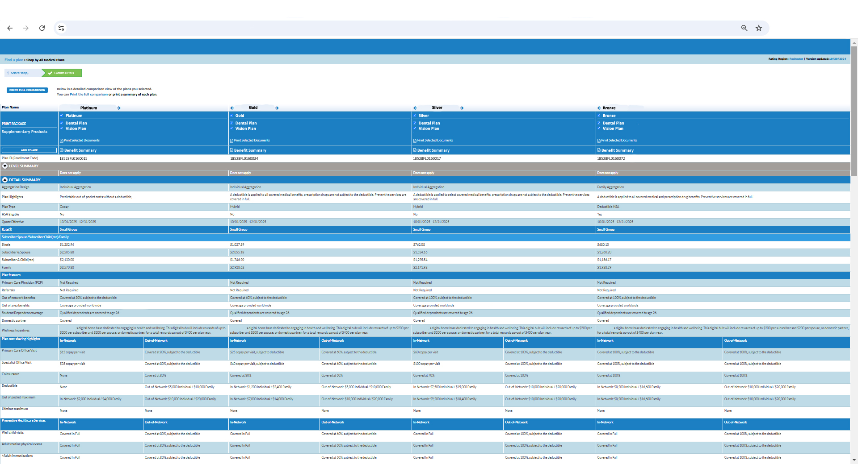
Detail Compare Page
Side by Side Comparison of every plan benefit (full details)

Slide 7
Summary
The slides shown above are only a small portion of this tool and its full capability.
This tool can be branded and adapted to any health, dental, or vision insurance company.
For a full presentation please contact Cyber Web Group LLC, mikemohr@cyberwebgroup.com (585) 305-7511

